Slide 1
GeoSocial-Aurora
Applying ML techniques for automatic tweet events classification
Rosa Filgueira

Slide 2
Introduction
Constant flow of information in the form of short texts makes (it in theory possible) to
collect real time information about all sorts of events that are being written about
In GeoSocial-Aurora:
catching the events related with “Auroras Borealis”

Slide 3


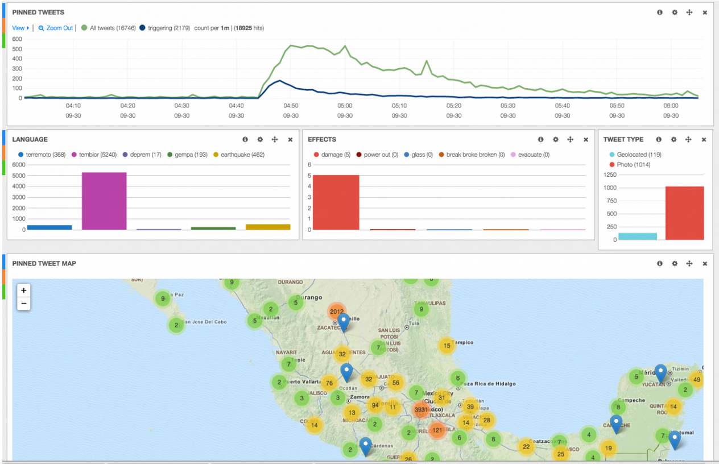
Problem description
How the twitter stream can be successfully exploited to this end isn’t straightforward
The detection of earthquakes on Twitter has been extensively documented (Sakaki, Okazaki, and Matsuo 2010) for Japan.

Slide 4
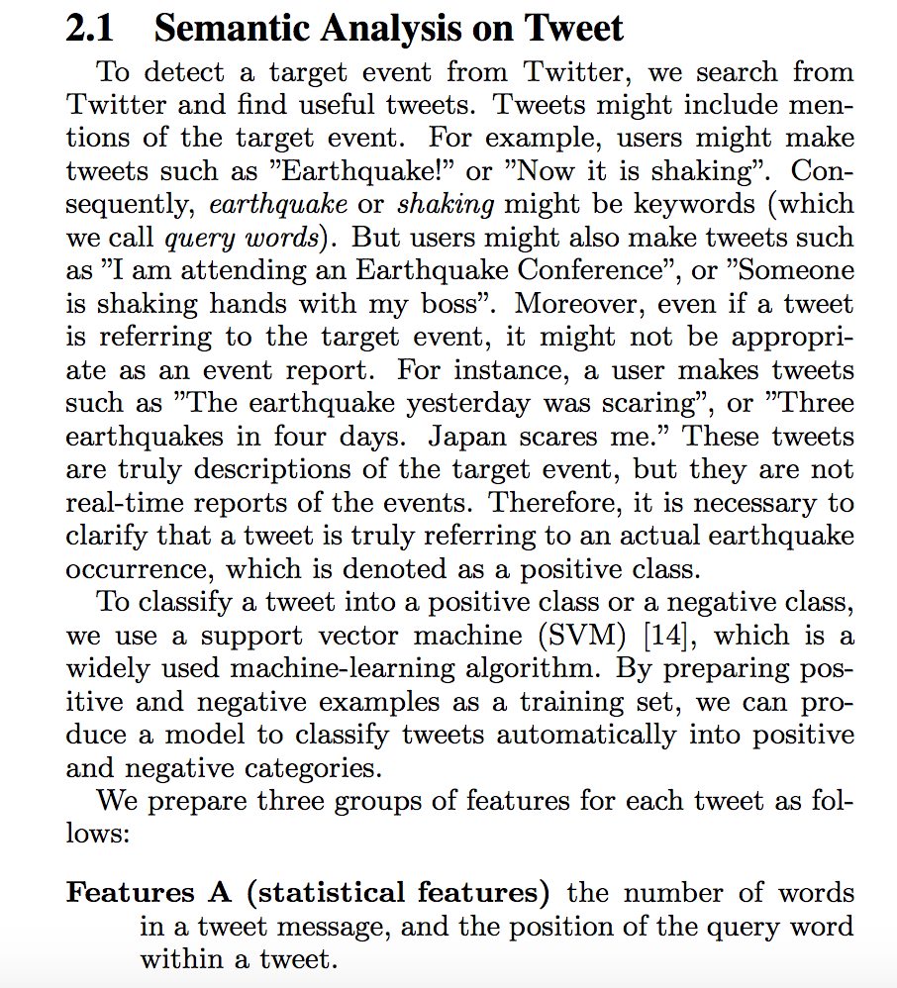
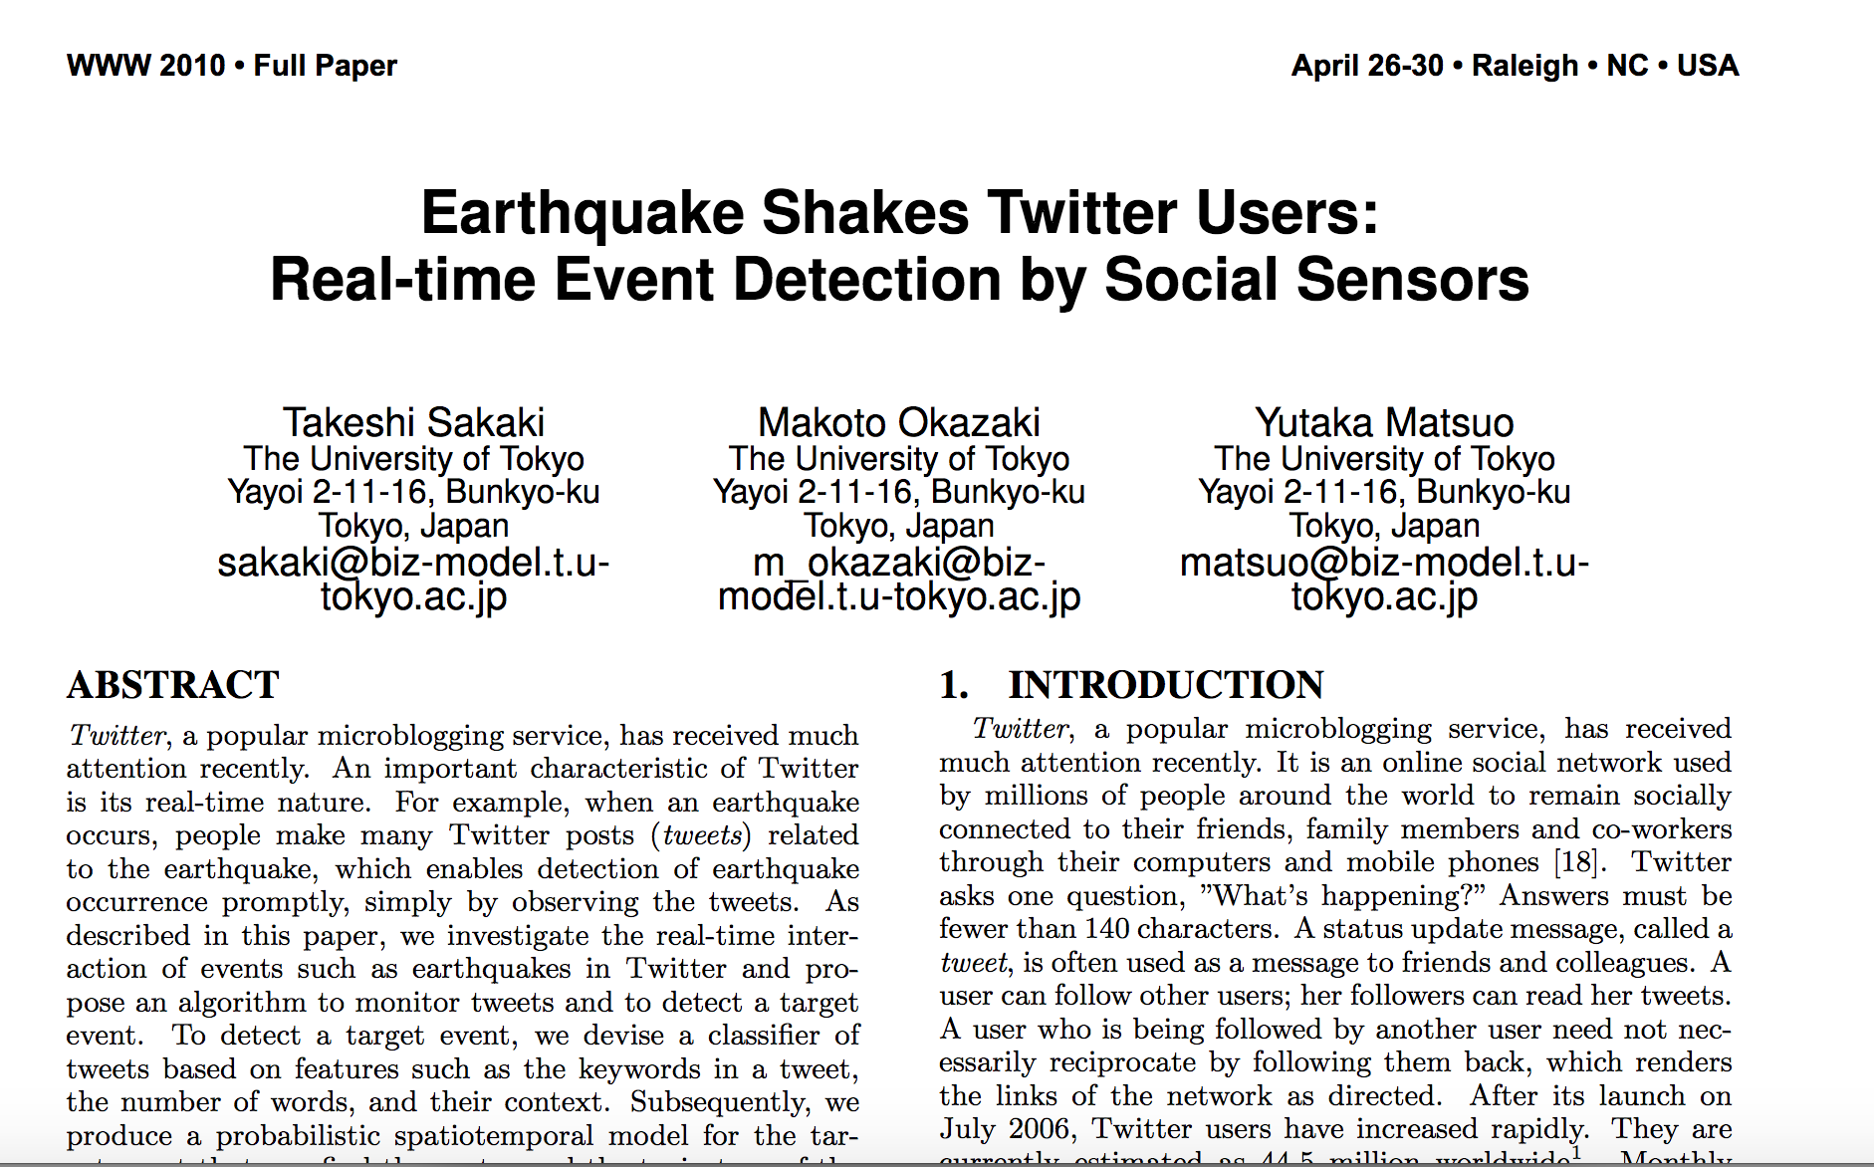

Slide 5
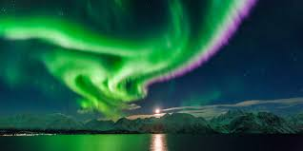

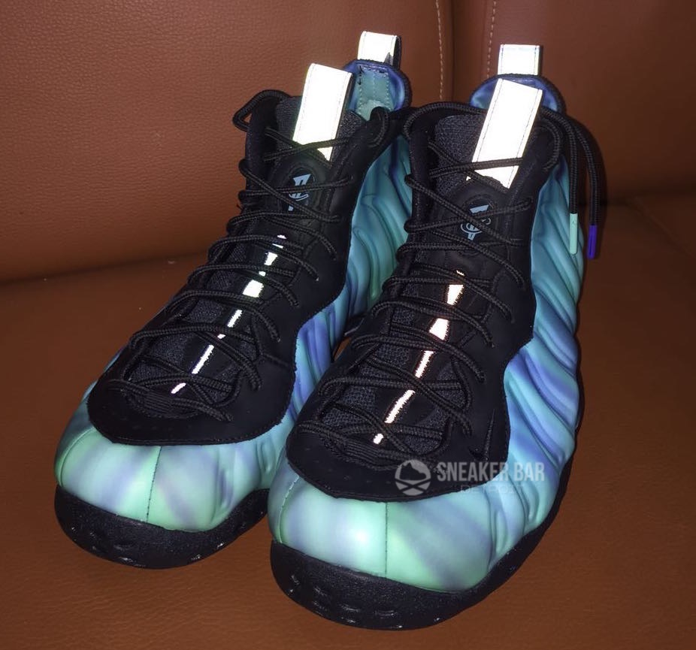

Problem description
Not all the tweets with the term “Auroras” are related with “Auroras borealis”.

Slide 6

Problem description
Non-Aurora-B.’ related events
Auroras’ B. related events
Can we just take a moment to admire Aurora's face in this pic
#northernlights visible over @kawarthalakes right now @AuroraMAX
I'm at Aurora Boulevard in Quezon City
Aurora Prediction: Kp: 4.67(20:15) 5.33(23:15) MDT (earth 5.33) Status: Moderate Storm
Hello Aurora, This is customized Tees and Hoodies with your name!
theyre was northern lights last night they were beautiful:)
NIKE DUNK HIGH PREMIUM SB NORTHERN LIGHTS
We currently have a G3 solar storm in progress brilliant chance of seen the Aurora tonight

Slide 7
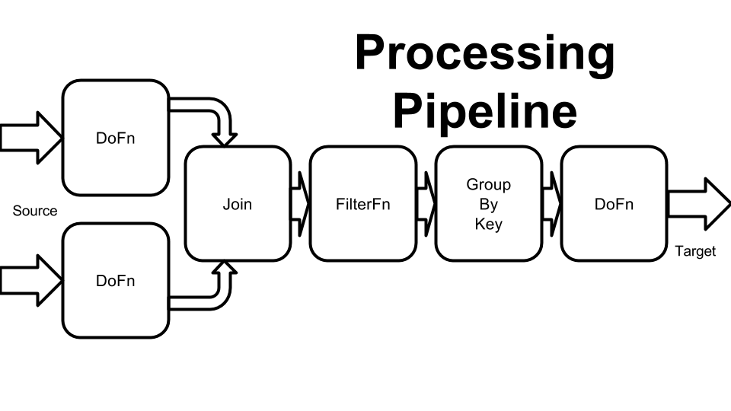
“Simple” objective(s)
From the tweets that are being collected:
Classify "automatically” the tweets that are related with Auroras borealis before plotting
Artificial Intelligence/Machine Learning/NLP
“Text” / “Sentence” / ”Topic” classification
Run some statistics
in “parallel”

Slide 8
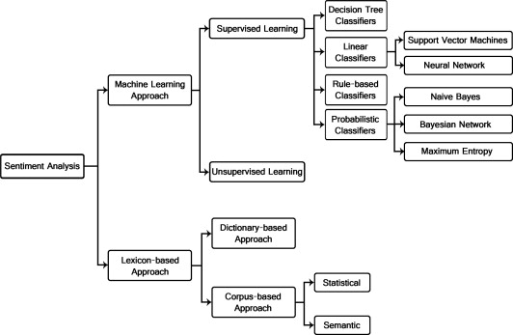
Approaches
Classifications

Slide 9
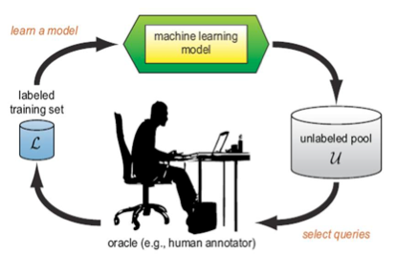
Machine Learning - Supervised Methods
Create training dataset :
Labels: “Others” and “Aurora”
Create a model/classifier :
Training process in which it is required:
to make predictions
Correct the model when those predictions are wrong.
The training process continues until
the model achieves a desired level of accuracy

Slide 10
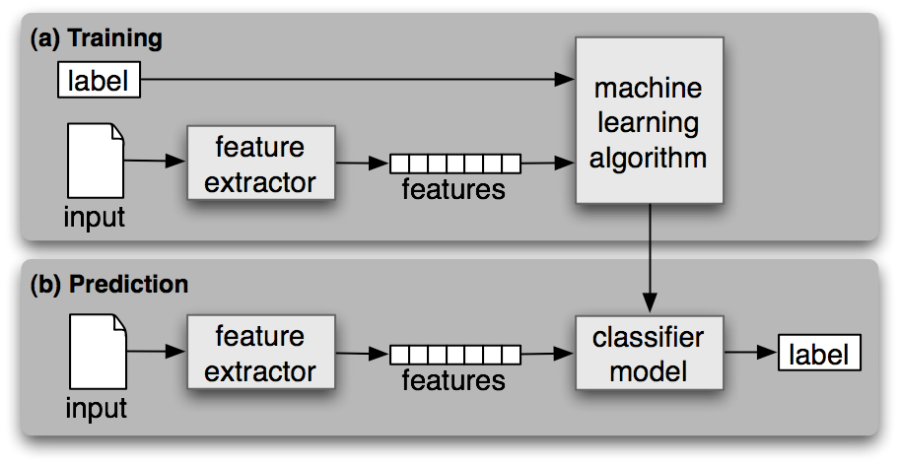
Machine Learning - Supervised Methods

Slide 11
Some ML algorithm types
Regression:
is concerned with modeling the relationship between variables that is iteratively refined using a measure of error in the predictions made by the model.
Logistic Regression, Linear Regression
Neural Networks:
are models that are inspired by the structure and/or function of biological neural networks.
Pattern matching that are commonly used for regression and classification problems.
Bayesian:
are those that explicitly apply Bayes’ Theorem for problems such as classification and regression.
Naïve Byes, Gaussian Naïve Bayes, Bayesian Network, ..
Deep Learning:
a modern update to Artificial Neural Networks that exploit abundant cheap computation.
They are concerned with building much larger and more complex neural
Convolutional Neural Networks (CNN), Deep Belief Networks (DBN), ….

Slide 12
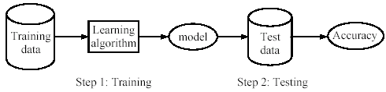
First Approach- Support Vector Machine Classifiers
Support Vector Machines (SVM) classify data into two classes (which is why it is called non-probabilistic binary classifier).
Learning algorithms ( ScikitLearn Library )
Linear Regression
Logistic Regression
Naïve Bayesian
Stochastic Gradient Descent
(given an input,
the classifier returns its probabilities to belong to each class )

Slide 13
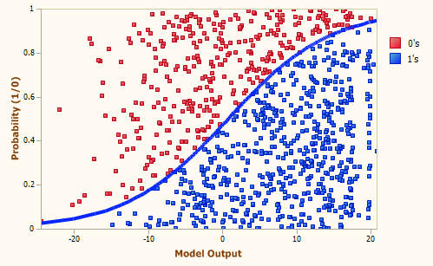
Methodology taken
Label manually 1300 tweets
“Auroras” or “Others”
Program a SVM model
Tested several algorithms and selected the one with the best accuracy → Logistic Regression
Example Logistic Regression model

Slide 14
Label tweets
Create a pipeline program (dispel4py) that automatically extract in parallel the text field from an collection of tweets and save them in a json file
Download data --- Diego gave them to me ---
Label manually the tweets
Code: https://github.com/rosafilgueira/Data_Wrangling/blob/master/SocialComputing_Example/labeling.py
dispel4py multi labeling.py –n 12 -d '{"read" : [ {"input" : "tweets_5000_page1.json"} ]}'

Slide 15
Program SVM model
Create a python program using several SVM algorithms from ScikitLearn Library (a Machine learning library)
Algorithms:
Multinomial Naïve Bayes
Linear SVC
Logistic Regression
Stochastic Gradient Descent
921 labeled tweets: 736 tweets for training each classifier, and 185 tweets for testing them
Code: https://github.com/rosafilgueira/Data_Wrangling/blob/master/SocialComputing_Example/svm_model/train_classifier_svm.py

Slide 16
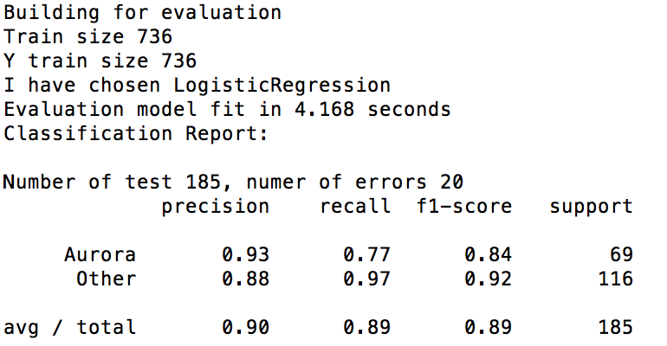
SVM- Logistic Regression - Accuracy

Slide 17
Apply the SVM classifier
Download data (5000 tweets) from a period of time with high activity of Auroras Borealis (8-9 May 2016)
Build a data-pipeline workflow (dispel4py):
Preprocess (using NLTK library)
Classification (Logistic Regression Model)
Store the classification results into a file
Run statistics with the ‘auroras’ tweets based in their locations:
Which US states registered more activity
Which UK countries registered more activity
Which UK regions registered more activity

Slide 18
Some “statistics” based on Country/State location – MapReduce --
Input data: 3419 tweets
Apply the classification model to the input data:
2024 tweets classified as “Others”
990 tweets classified as “Auroras” but their location is not from US neither UK
405 tweets classified as “Auroras” from US or UK
369 tweets classified as “Auroras”- mapped by “US” - reduced by “state”
Washington, 60
Alaska, 50
California, 26
Montana ,24
Indiana, 22
36 tweets classified as “Auroras” - mapped by “UK” - reduced by “country”
Scotland, 18
England, 14
Wales, 4

Slide 19
Some “statistics” based on Country/State location -- MapReduce
69 tweets classified as “Auroras” - mapped by “UK”- reduced by “region”
Northern Ireland, 12
Yorkshire, 9
North West, 9
South East, 7
Great London, 7

Slide 20
Second approach – Deep Learning
Convolutional Neural Network (CNN) – “deep learning”
Build the CNN classifier/model
TensorFlow as a data-pipeline as an engine
Compare both approaches

Slide 21
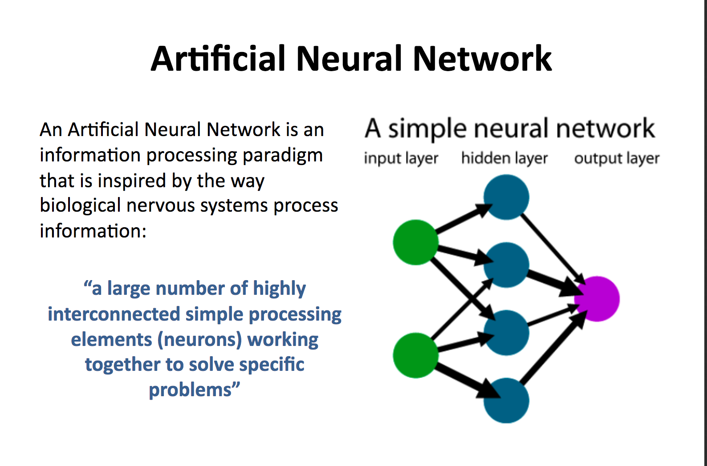
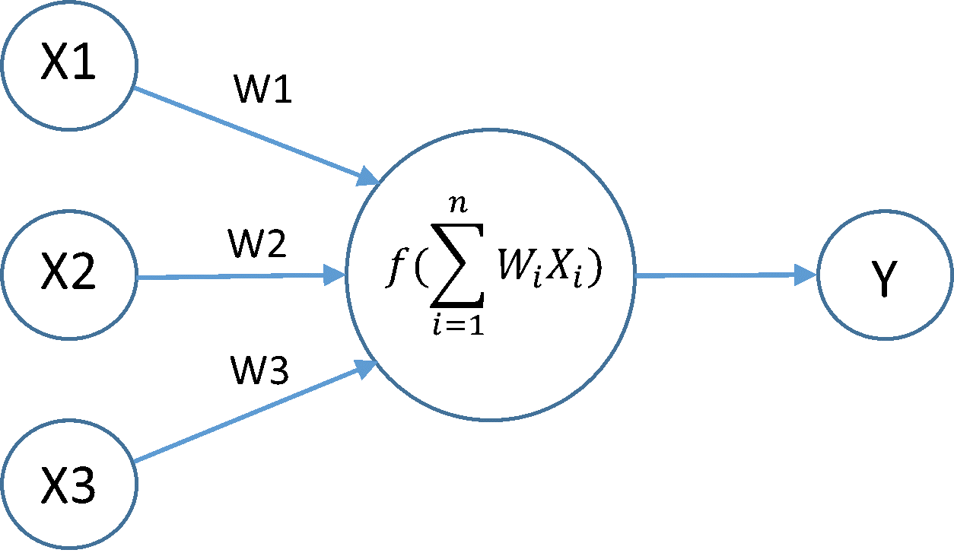
Activation function
“Learn the weights”
(perceptron neural networks)

Slide 22
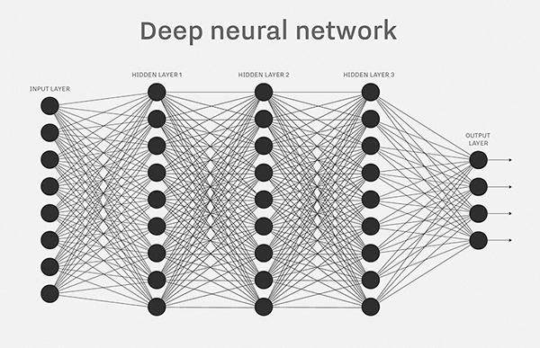
Deep Learning
Many layered neural networks
The more layers in a neural network, the more abstract features can be represented

Slide 23
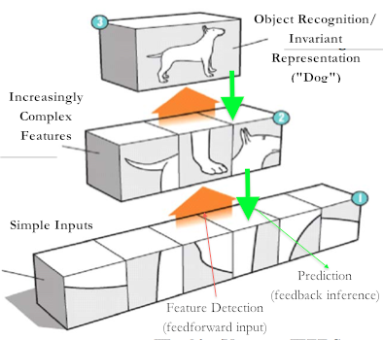
Classification between cat vs dog:
Top Layer: Cat or Dog
Higher Layers: Body, head, legs
Middle Layers: Fur patterns, eyes, ears
Bottom Layers: Edge detectors, curves, corners straight lines

Slide 24
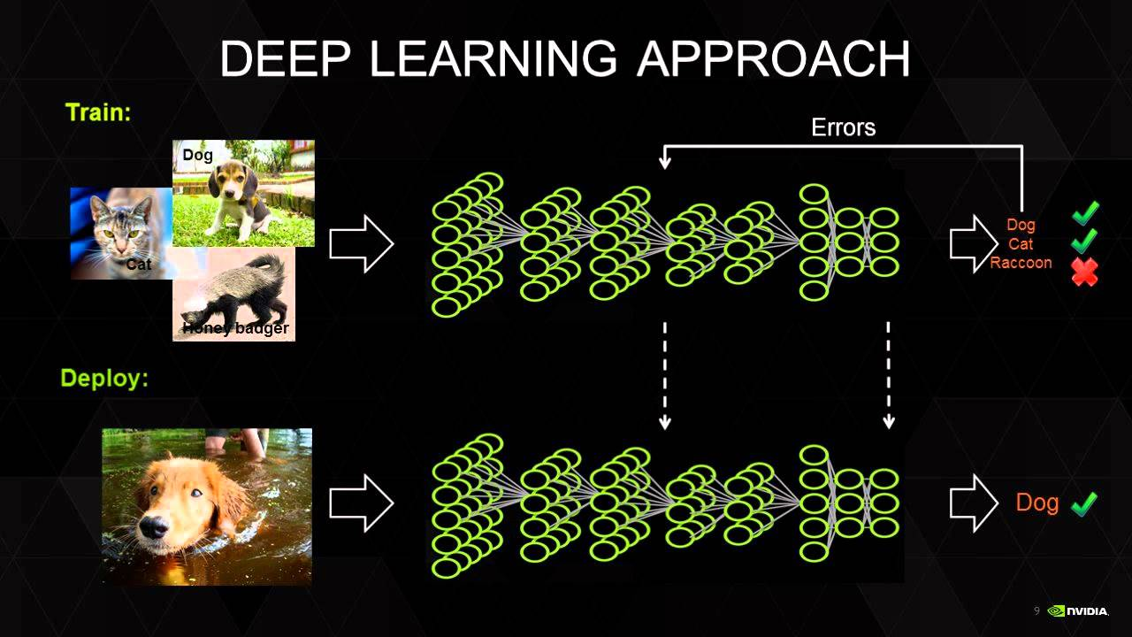
Deep Learning

Slide 25
hmmm… OK, but:
Multilayer neural networks have been around for
25 years. What’s actually new?

Slide 26
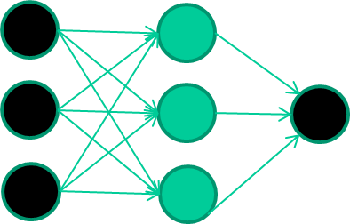
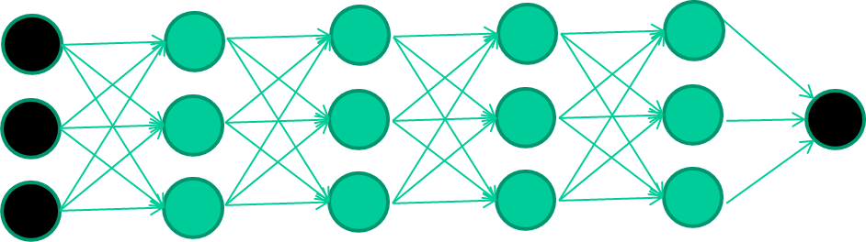
hmmm… OK, but:
Multilayer neural networks have been around for
25 years. What’s actually new?
we have always had good algorithms for learning the
weights in networks with 1 hidden layer
but these algorithms are not good at learning the weights for
networks with more hidden layers
what’s new is: algorithms for training many-later networks

Slide 27
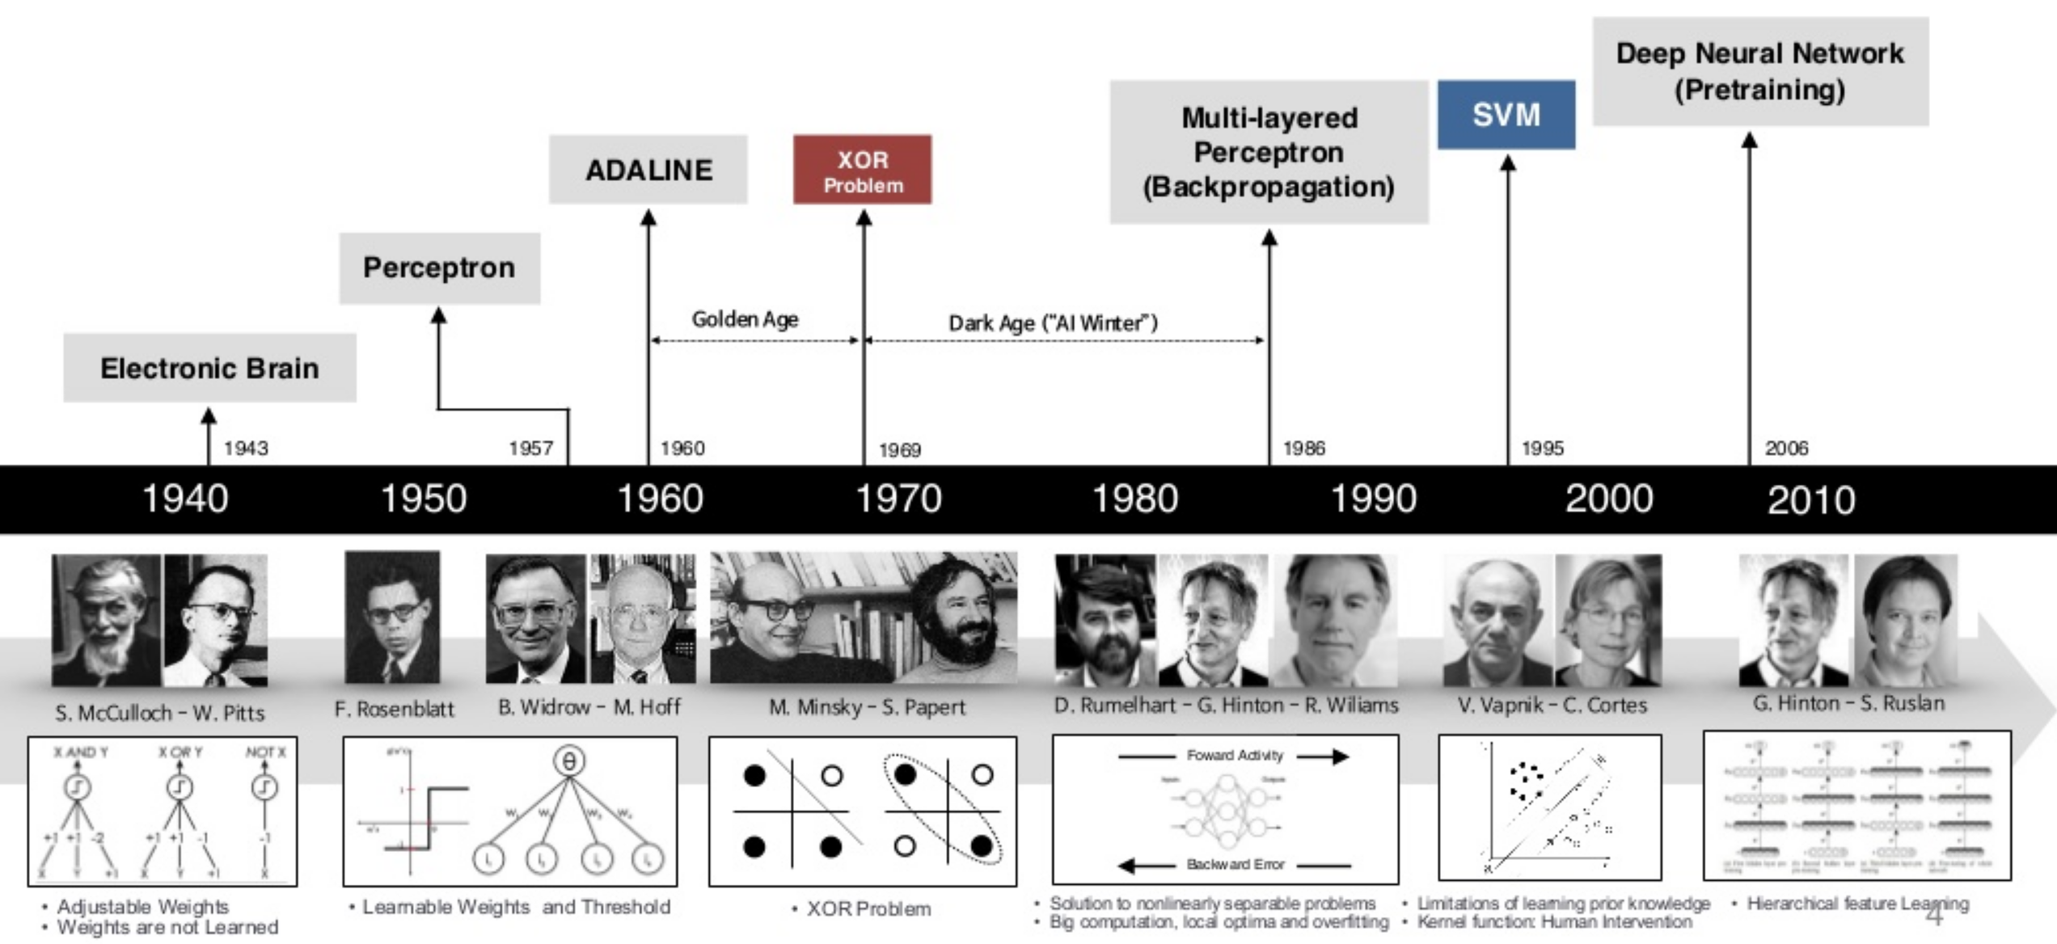
hmmm… OK, but:
Multilayer neural networks have been around for
25 years. What’s actually new?

Slide 28
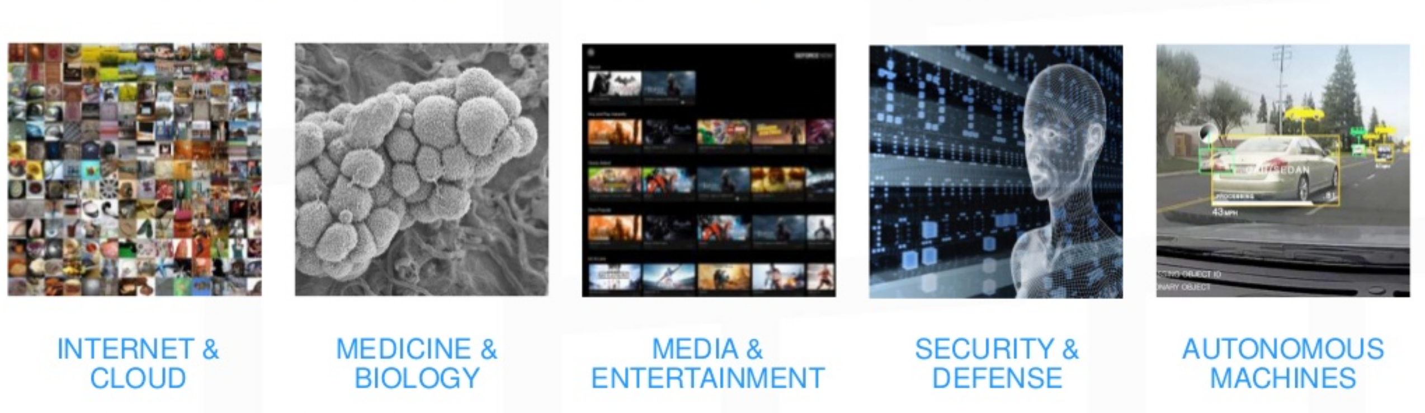
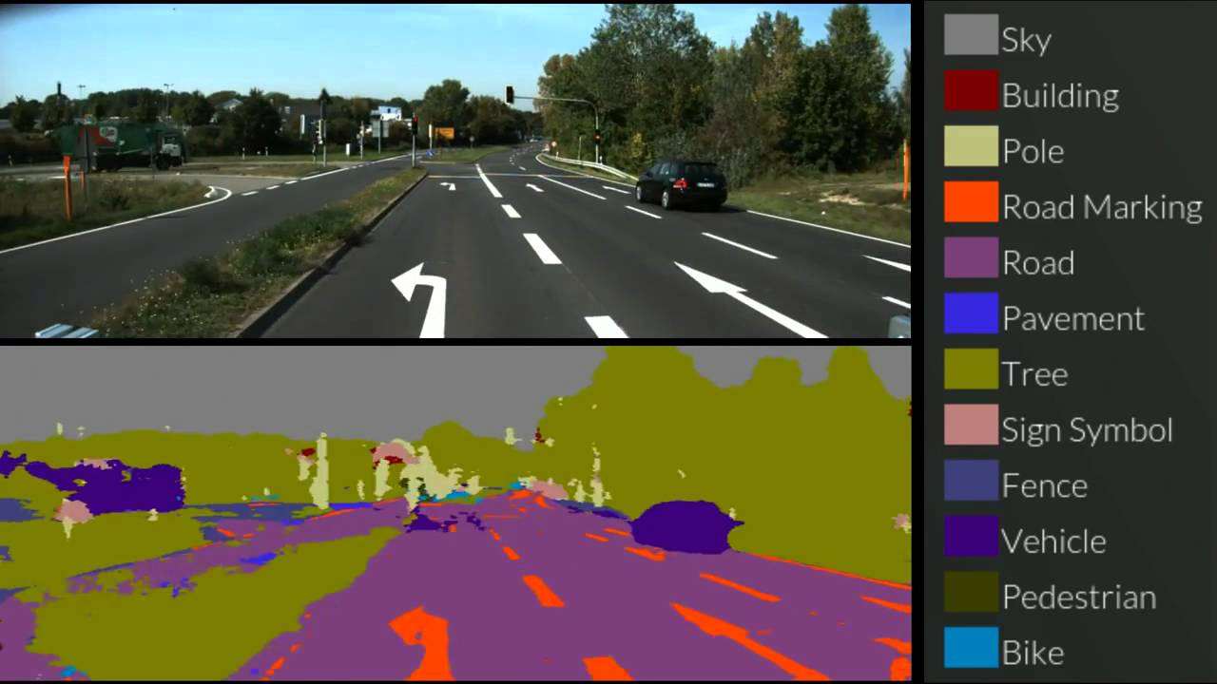
Deep Learning – Many applications
The fastest growing field in AI
Many applications:
Forecasting/Predictions
Image recognition
Speech recognition/ translations
Text classification
Many fields

Slide 29
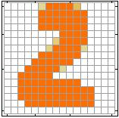
Example Application
Handwriting Digit Recognition
Machine
“2”
Notes:
“Hello world” for deep learning
Data: http://yann.lecun.com/exdb/mnist/

Slide 30
Handwriting Digit Recognition
Input
Output
y₁
is 1
0.1
y₂
is 2
0.7
The image is “2”
……
……
……
y₁₀
0.2
is 0
16 x 16 = 256
Ink → 1
No ink → 0
Each dimension represents the confidence of a digit.
Notes:
The same for even more complex tasks.

Slide 31
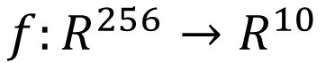
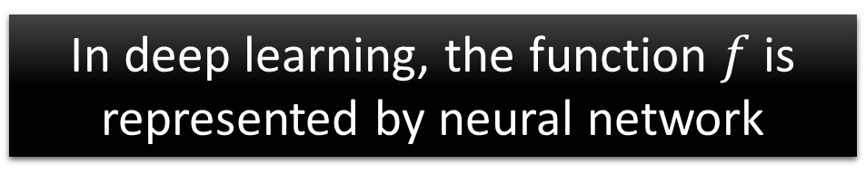
Example Application
Handwriting Digit Recognition
y₁
Machine
y₂
“2”
……
……
y₁₀
$$f:R^{256}→R^{10}$$
In deep learning, the function $f$ is represented by neural network

Slide 32
Neural Network
neuron
Input
Layer 1
Layer 2
Layer L
Output
……
y₁
……
y₂
……
……
……
……
……
……
y_{M}
Input Layer
Output Layer
Hidden Layers
Deep means many hidden layers
Notes:
Fully Connected Feedforward Network
You can always connect the neurons in your own way.
“+” is ignored
Each dimension corresponds to a digit (10 dimension is needed)

Slide 33

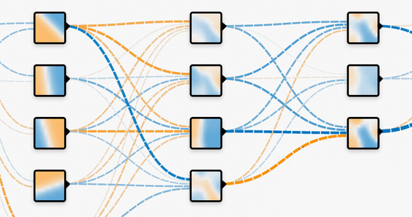
What is Tensorflow?
Python-based neural network framework
Google open source project on Github
Released November 2015
TensorFlow: open source software library for numerical computation using data flow graphs
Nodes in the graph represent
mathematical operations
Edges represent the multidimensional
data arrays/tensors that flow between them.

Slide 34
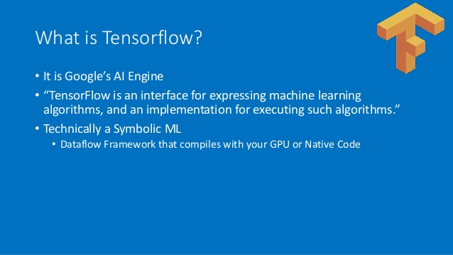
Tensorflow - Google
Python-based neural network framework
Google open source project on Github
Released November 2015

Slide 35
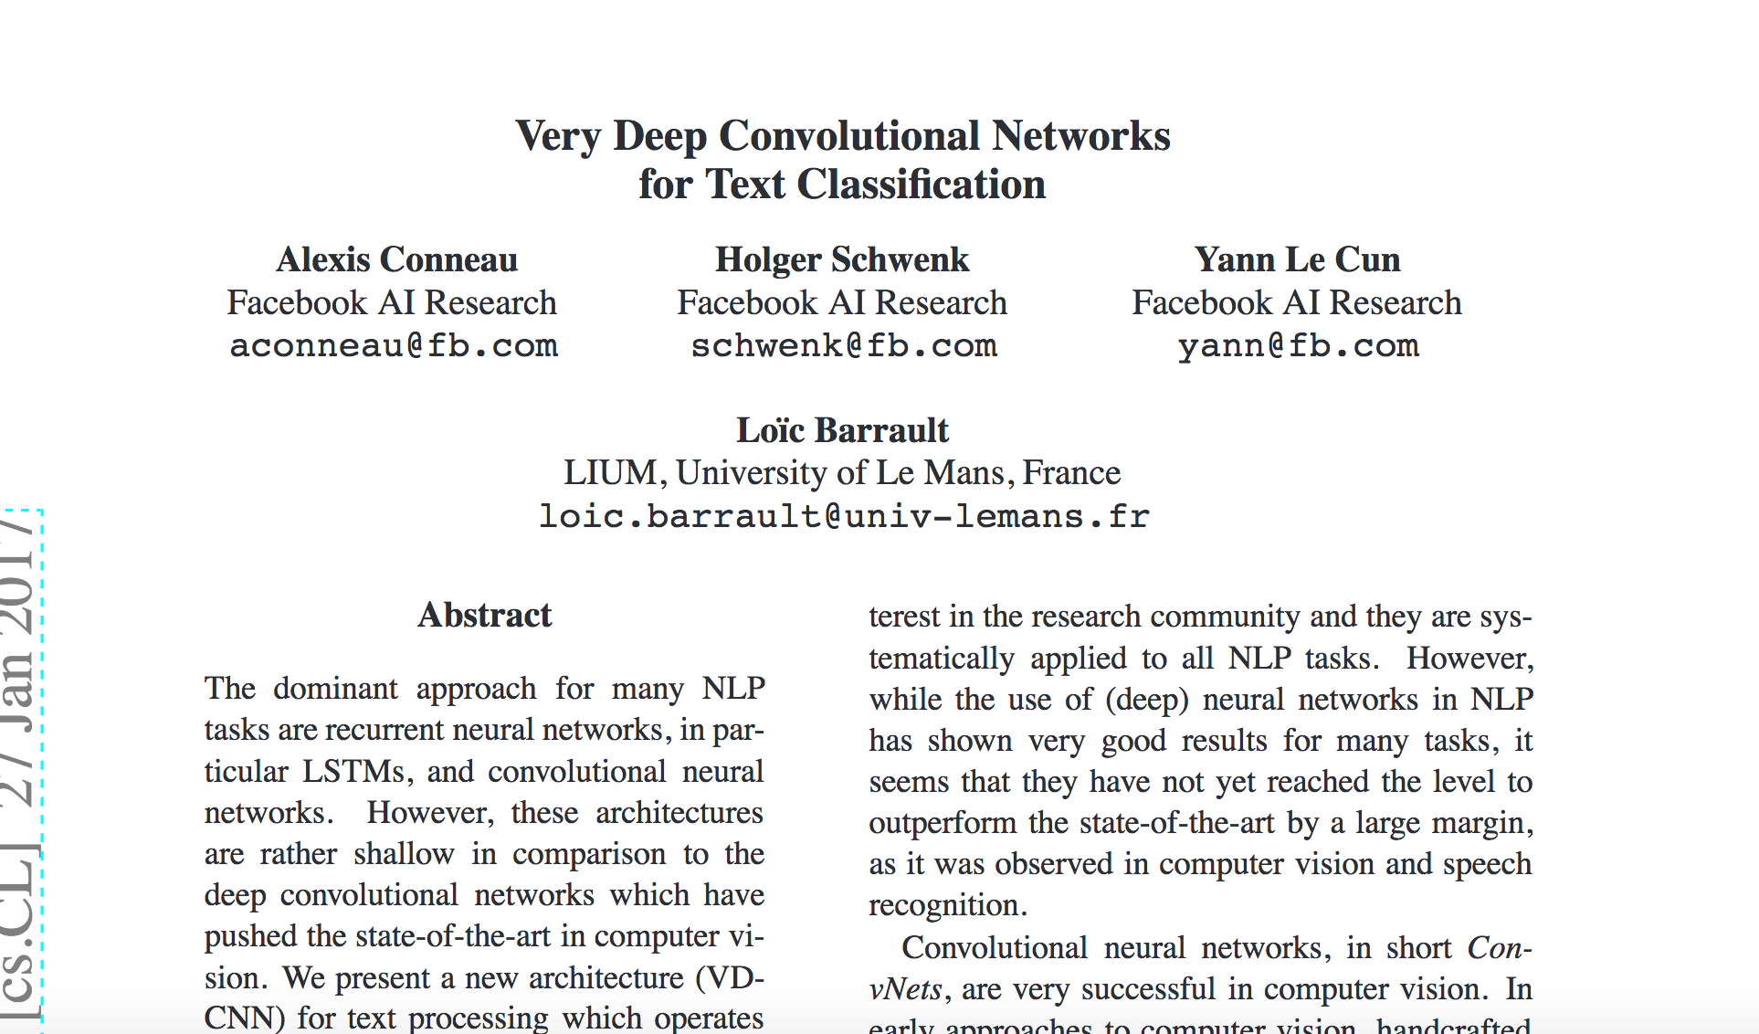
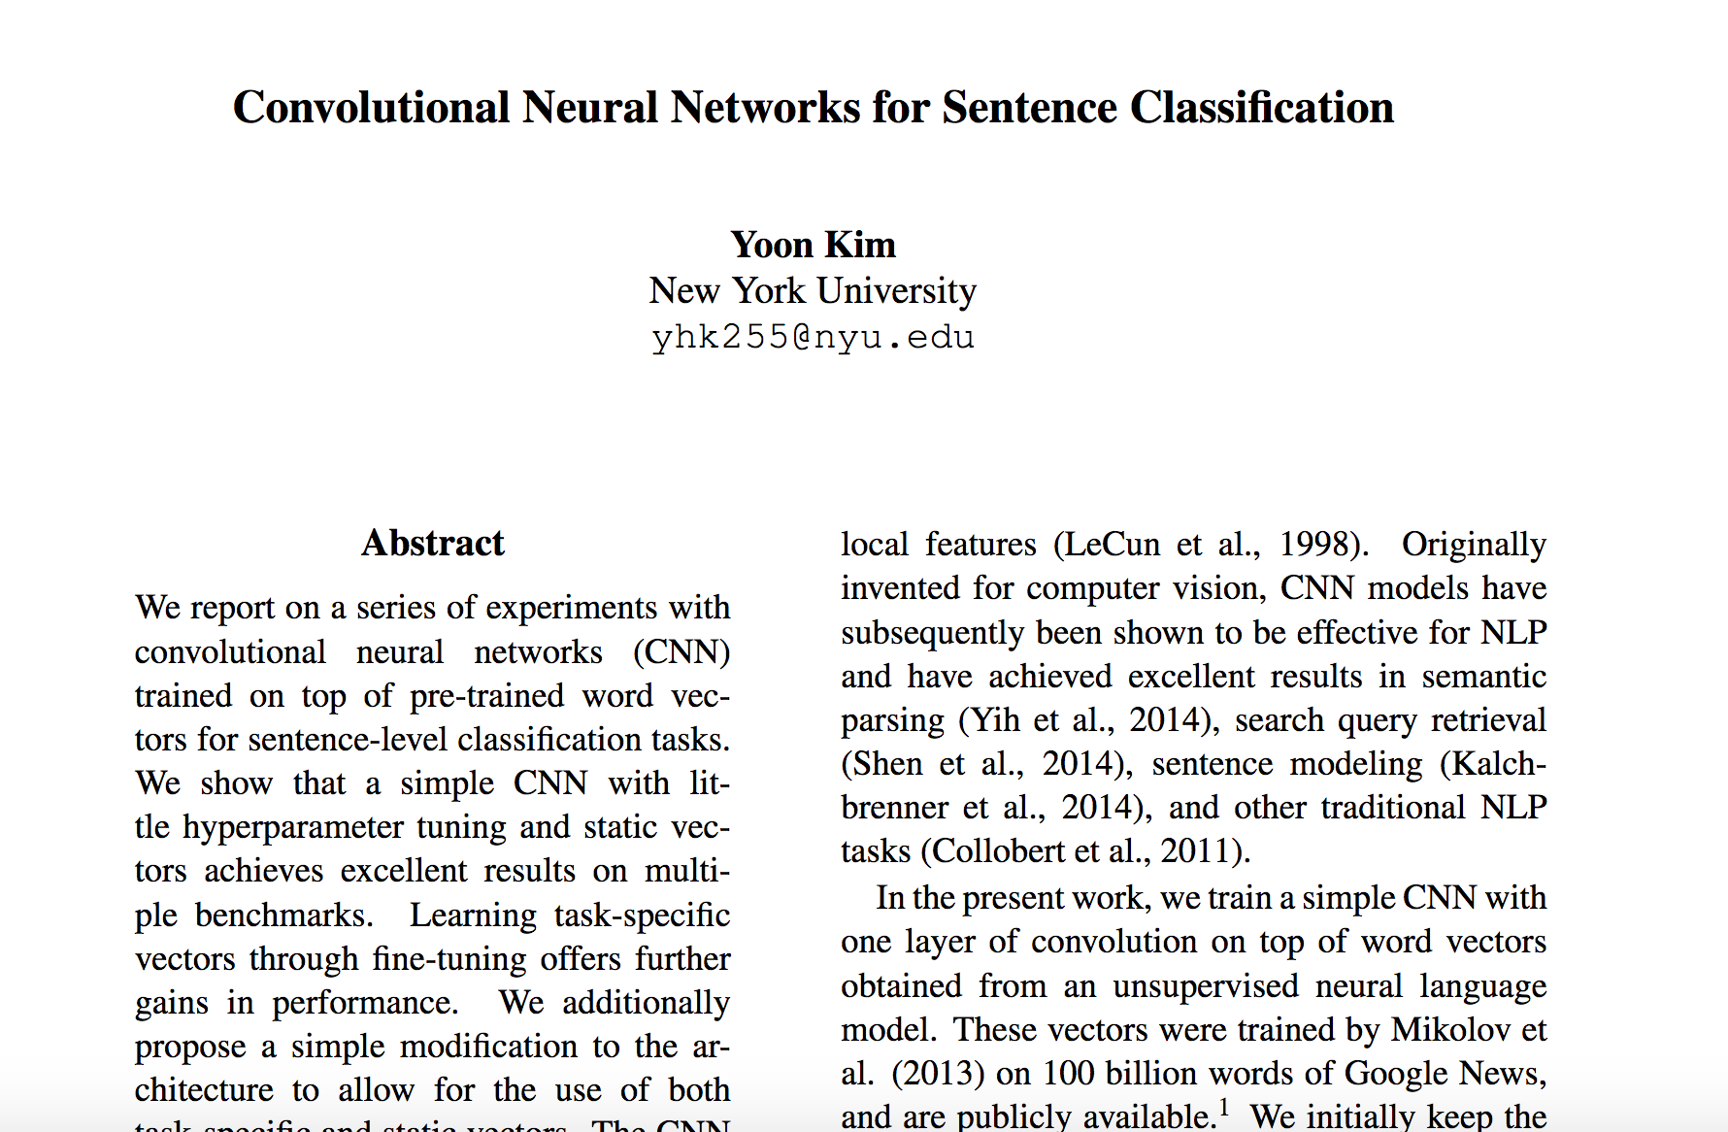
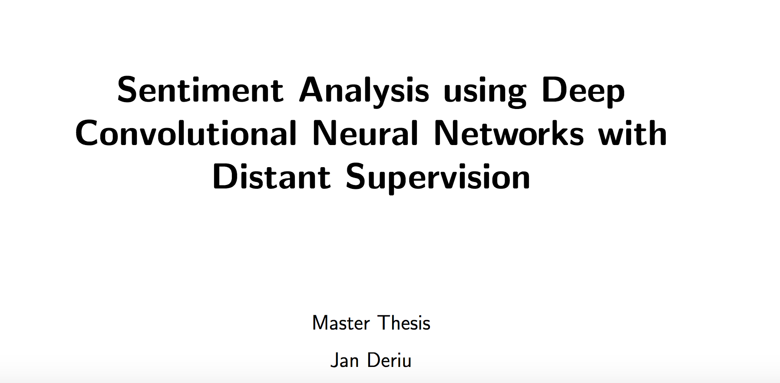
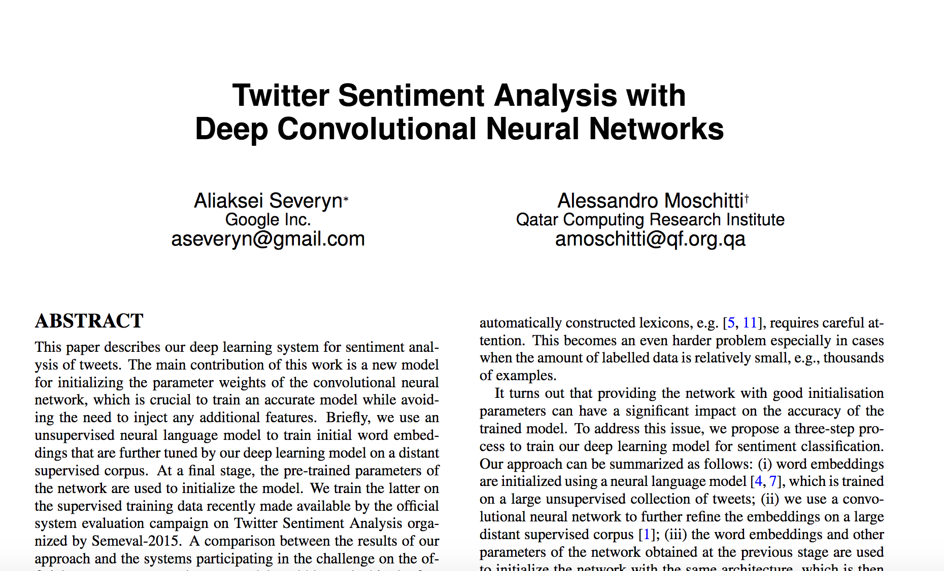
Convolutional Neural Network
Convolutional Neural Network (CNNs)
Traditional applied to computer vision.
More recently CNNs to problems in Natural Language Processing (NLP)

Slide 36
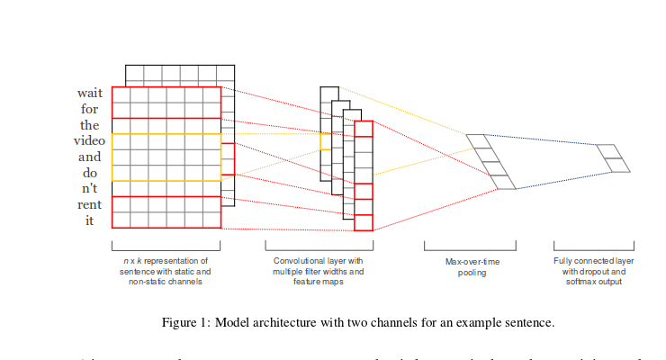
Convolutional Neural Network
Kim (2014): Sentence classification
Notes:
Efficient Estimation of Word Representations in
Vector
Space
.”
Mikolov
et al. (2013)
-
Google

Slide 37
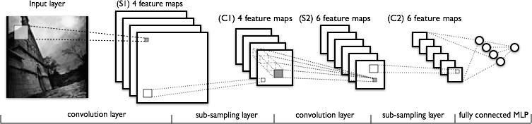
Convolutional Neural Networks
C layers are convolutions, S layers pool/sample
Often starts with fairly raw features at initial input and lets CNN discover improved feature layer for final supervised learner – eg. MLP/BP
Notes:
Each feature map should learn a different feature.
Brute force effort to see if and where certain features exist.
Pooling/sampling – Does the feature exist in a general area
Final standard supervised layer

Slide 38
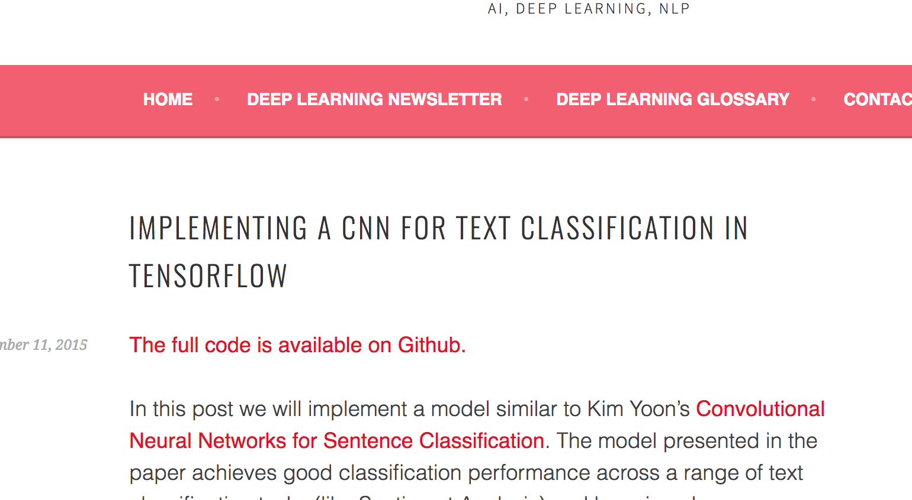
CNN + TensorFlow

Slide 39
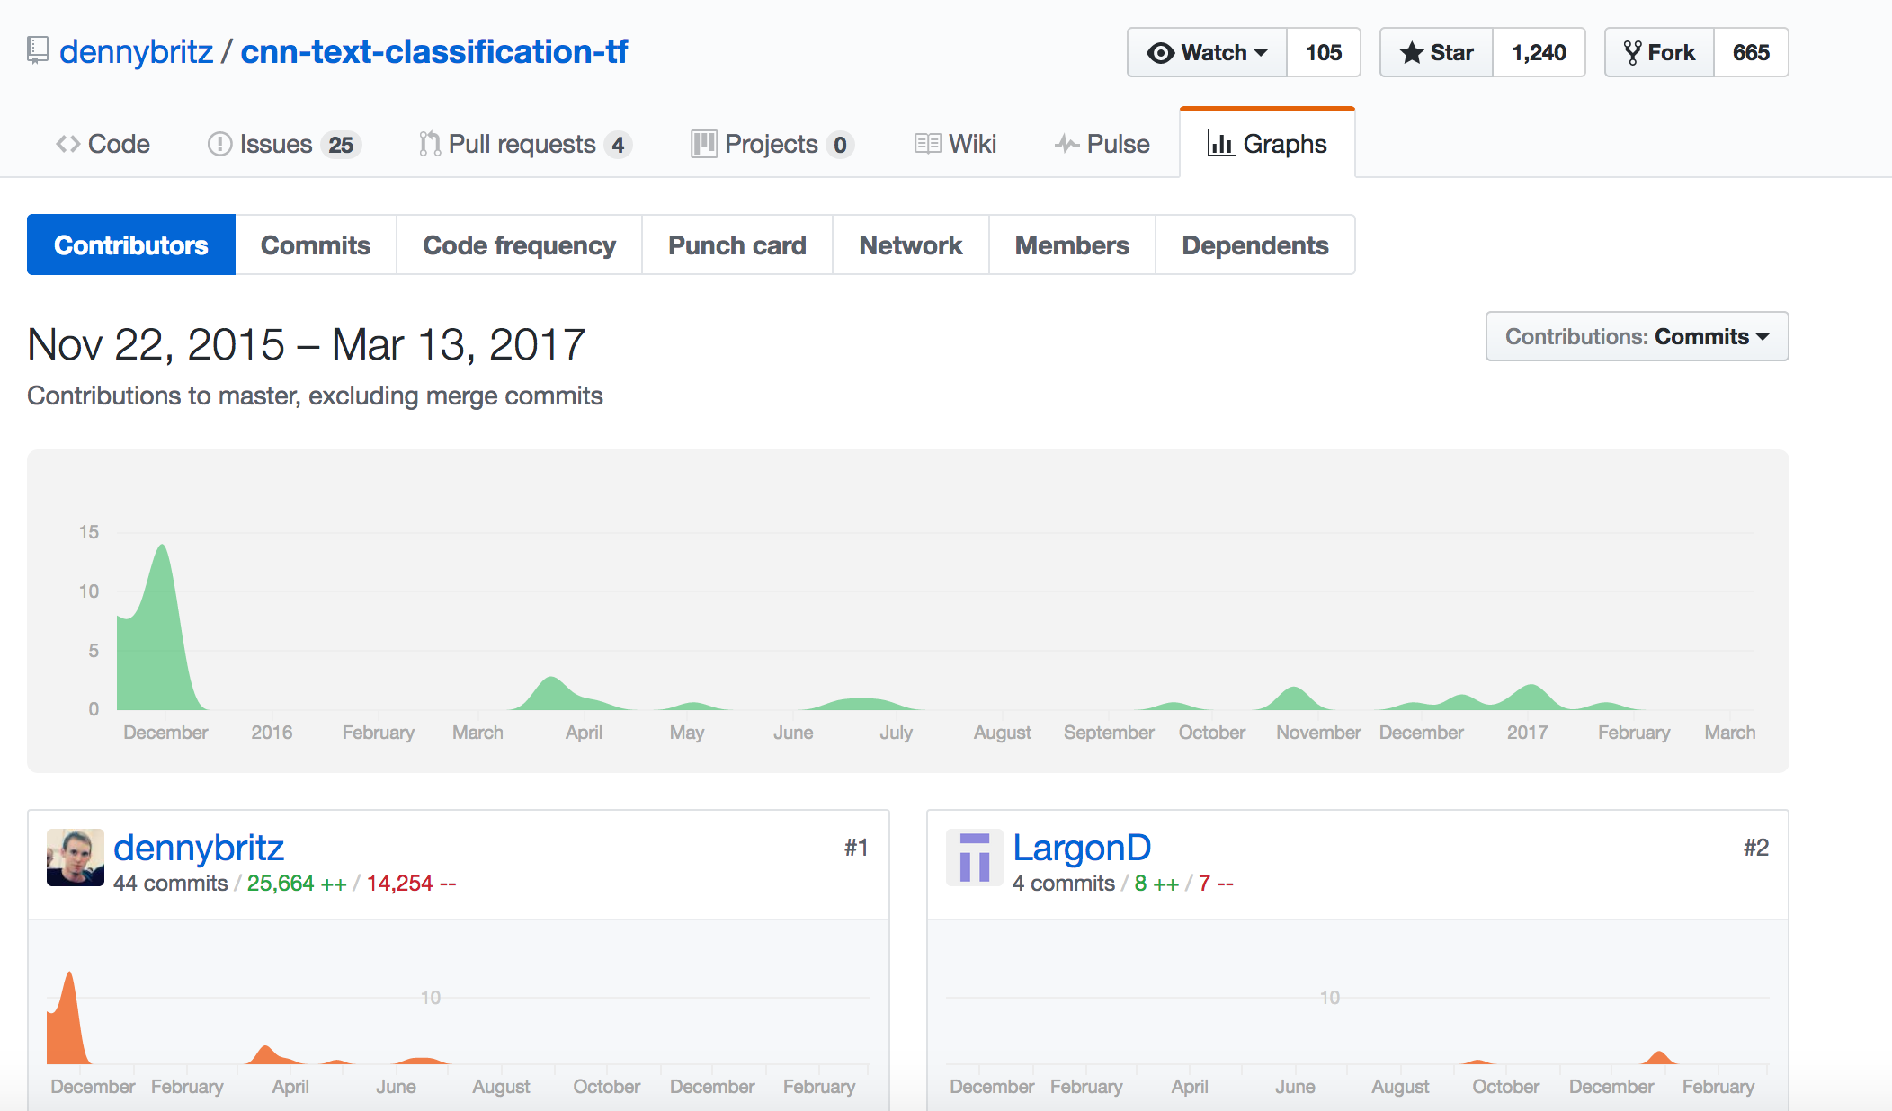
cnn-text-classification-tf

Slide 40
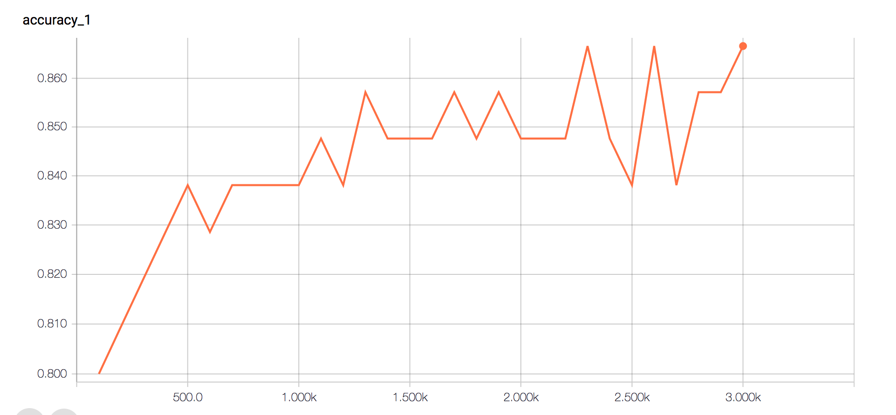
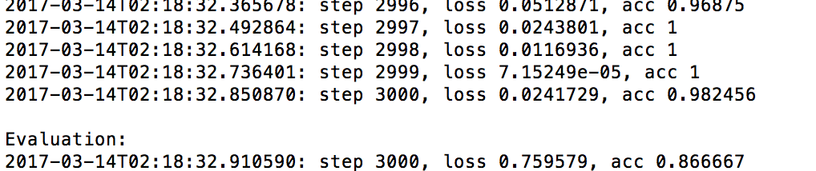
Methodology taken
Modification of the original CNN code for working with our data
Train data and build CNN classifier
Run the CNN with non-labeled data

Slide 41
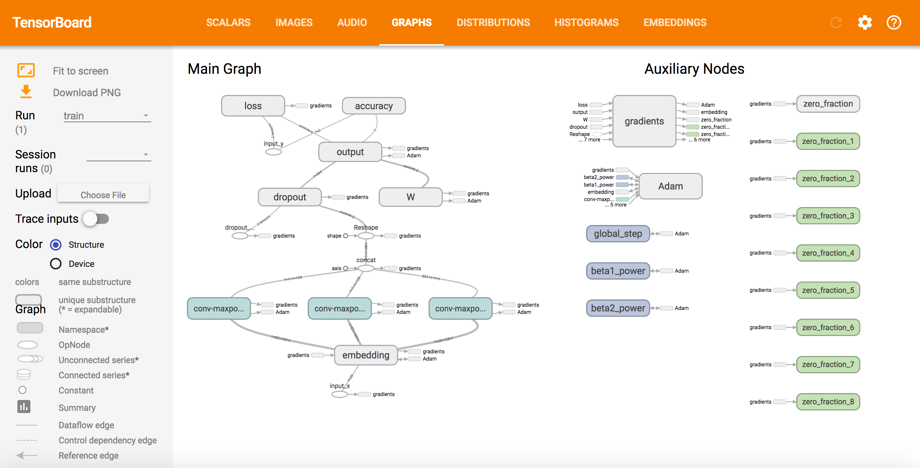
TensorBoard

Slide 42
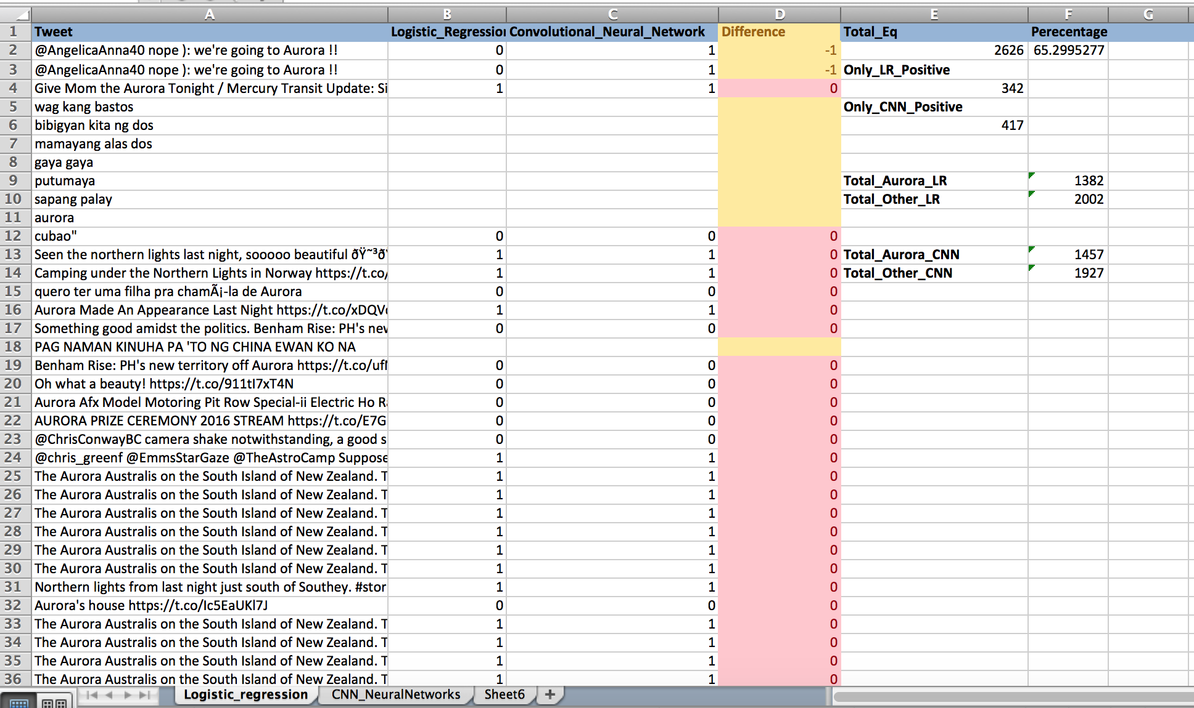
CNN vs LR

Slide 43
Deep learning vs SVM
Deep learning is a way of having several transformations in a row, to combine layers and layers of features.
SVMs typically only allow a single transformation.
Neural networks allows dozens (to hundreds in the latest papers) of layers.
Kernel SVMs are like a 2 layer neural network.

